Slide 2
What did we do today?
WE LEARNED MORE ABOUT SUSTAINABILITY
WE FOCUSED ON FOOD WASTE
—FOR THE PLANET
—FOR HUMANITY
—FOR OUR PROFESSION
THIS IS ALL LEADING SOMEWHERE
TO ACTION…..

Slide 3
THE FOOD WASTE CHALLENGE
Consists of 2 parts:
—foodservice operational challenge
—food waste education for 9-14 year olds
Choose to do one, or even both!

Slide 4
Sign up
Kick off boh
Baseline
Commitment
Toolkit and
check-in
6. Final results 6 mo.
7. Continue boh, start
foh

Slide 5
Sign up!

Slide 6
food waste education for youth in partnership with Electrolux, aiesec and world’s largest lesson
Intro activities
Intro global goals
Connecting global goals to real life
Self-assessment
Group discussion
Conclusion
And more….
The Global Goals Food Project
Food Heroes
Pilot in fall, specific date in spring

Slide 7
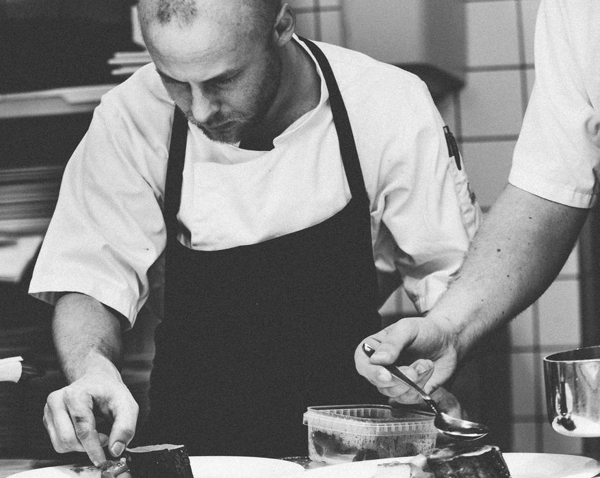
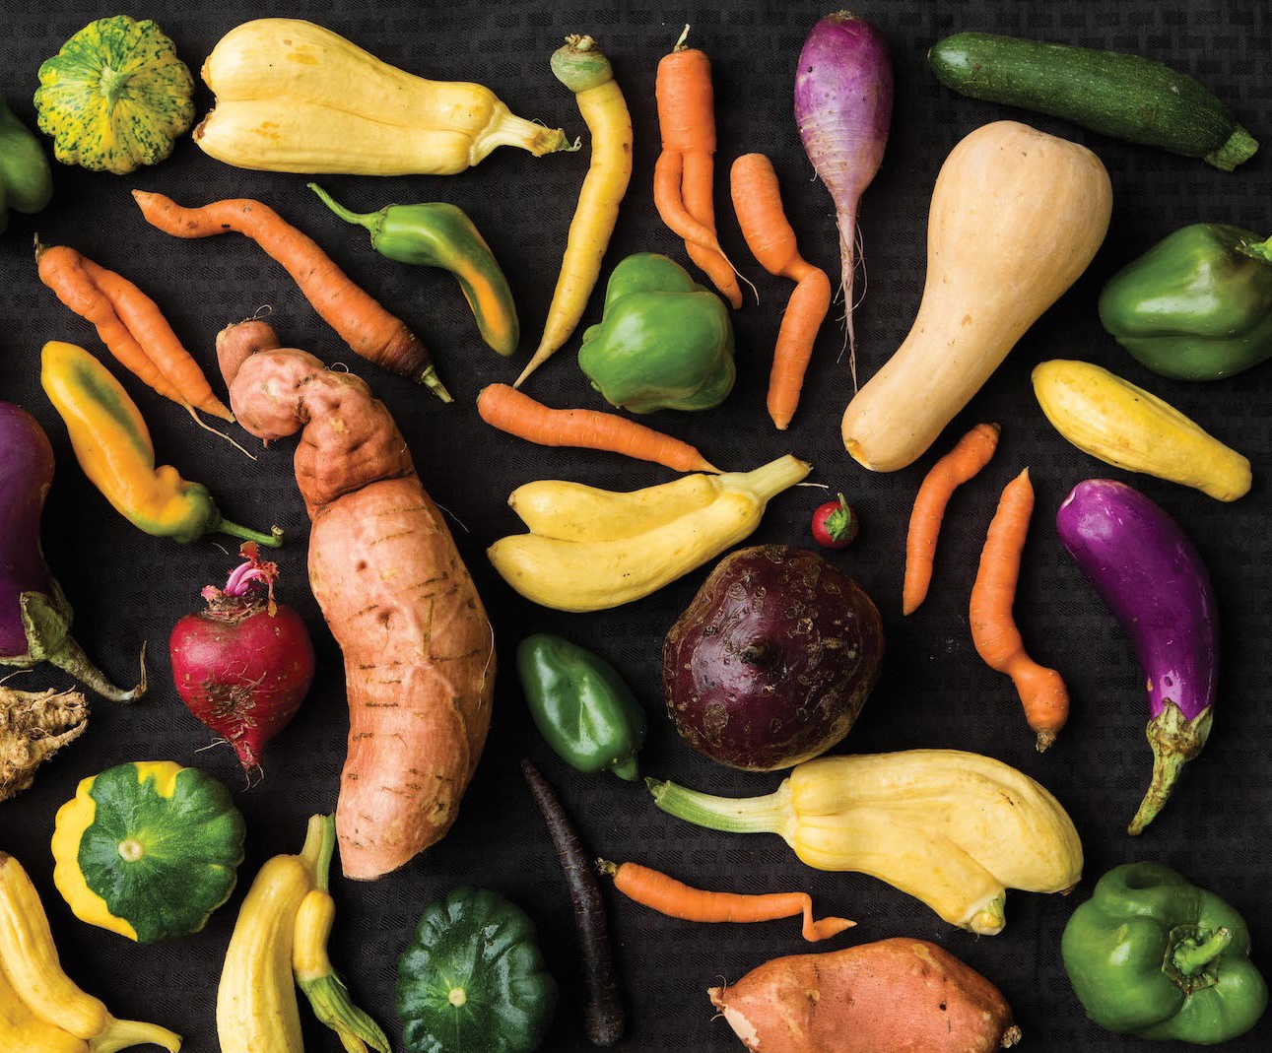
If we all work together as chefs, we will make a huge impact—and the world needs us!

